Slide 1
HouseKeeping
Submitted by :- Submitted to:-
Shreya Pradhan(15ca77) Ms.Usha Kiarana
Sushil Ranjan(15ca86)
Vinay Jain(15ca90)

Slide 2
Introduction
Whenever people shift from one place to another, they have a problem in searching servants.
Everything nowadays happens online so, we decided to search servants also online.
So, this is a website where people can find servants, on the basis of their needs, no need to search here and there or asking neighbors for servants.
In this website, there are 4 categories of servants, the customer can select the type of servant he wants.
Customers can search servants according to their area.
If the customer is logged in, then only he can see the details of the servants otherwise not.

Slide 3
Literature Survey
In this literature survey, we have compared the old methods , with the methods that we have used.
In olden days , people used to find servants by searching here and there.
The purpose of this literature review was to explore the online searching experience and evaluate why consumers should search servants online as opposed to physically searching.
Research and findings- There are no Previous researches conducted on the online searching of servants, that indicates that convenience and time are the major factors affecting the decision to search a servant online. It may also found that young consumers will more likely to prefer online searching of servants.

Slide 4
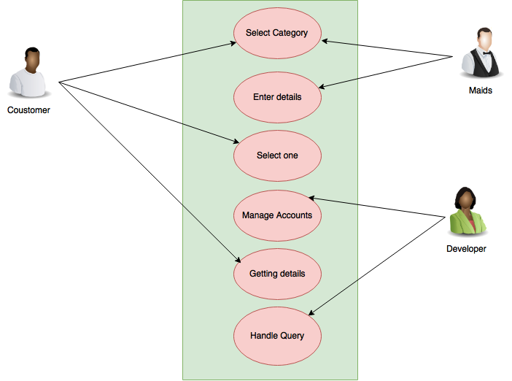
Design

Slide 5
Algorithm
Customer signup.
Customer login.
Password and user name is checked, if correct then logs in otherwise error.
If password incorrect then, a mail is send to the customer id, where his old password will be there, he can use it to log in.
After log in, he can see a home page containing the names of servants, he can choose it from here or he can select a particular category from the menu.
By doing this, he will be able to get the details of a particular servant. Then, he can ask personally from that servant

Slide 6
Continue..
IF the customer is a job finder, then there is a different procedure.
He will signup as a job finder.
He will login as a job finder.
After logging in he, will get his own profile, where if wants to edit something he can edit it.
He will also get mails, if he has been hired by a customer.

Slide 7
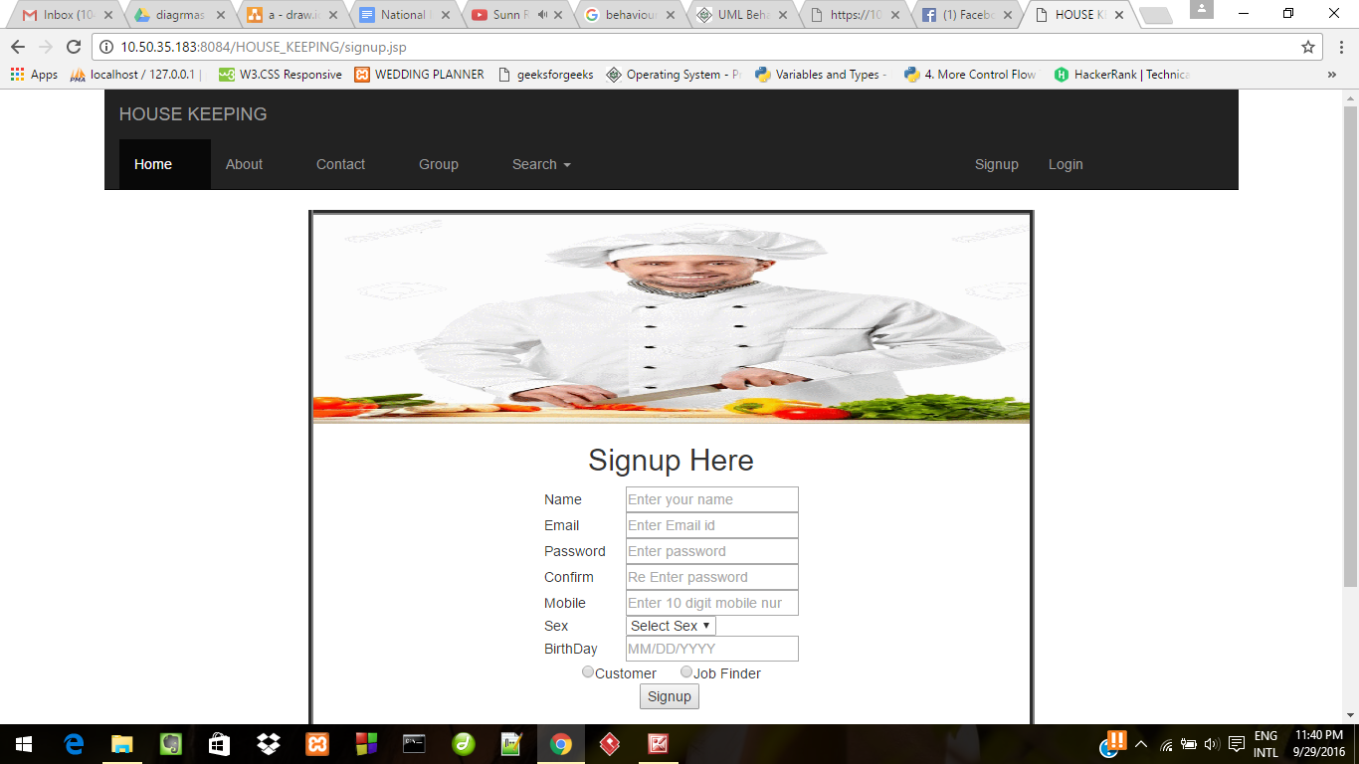
Testing

Slide 8
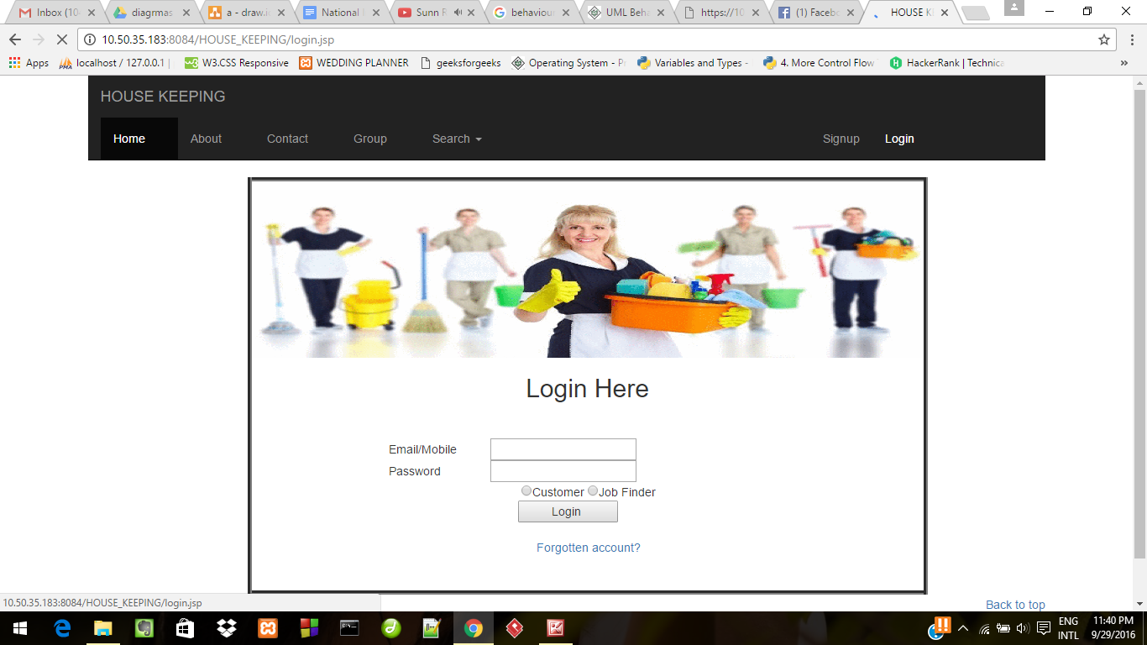
Continue..

Slide 9
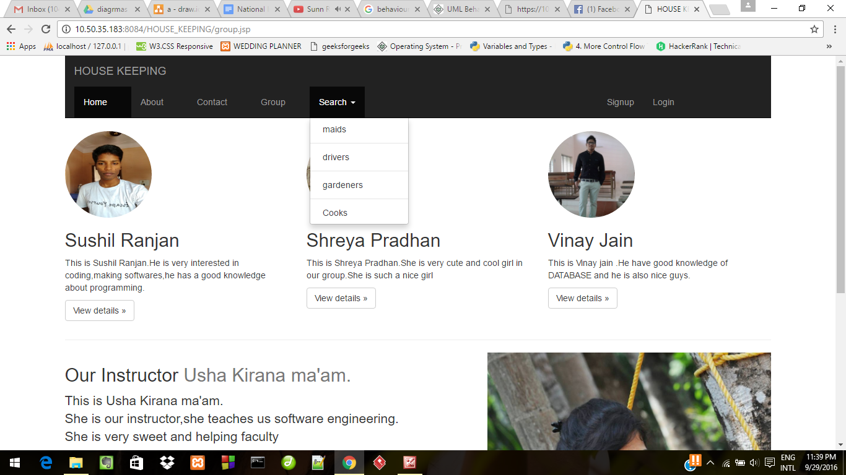
Snapshots

Slide 10
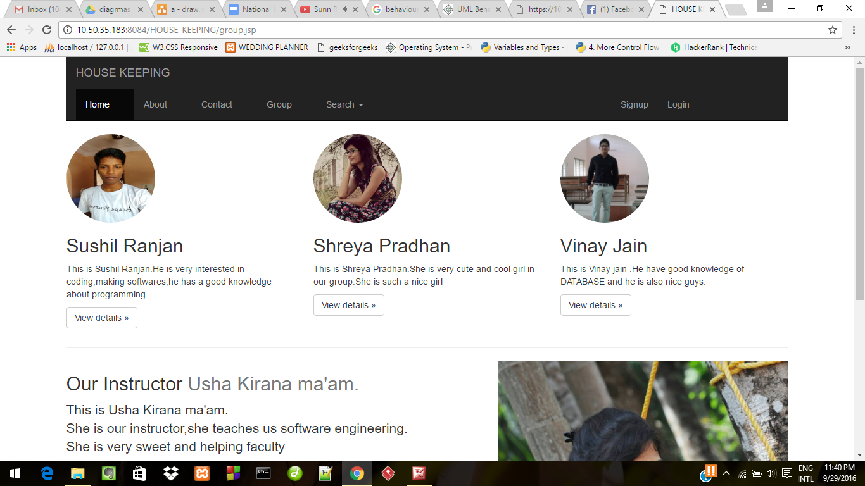
Snapshots..

Slide 11
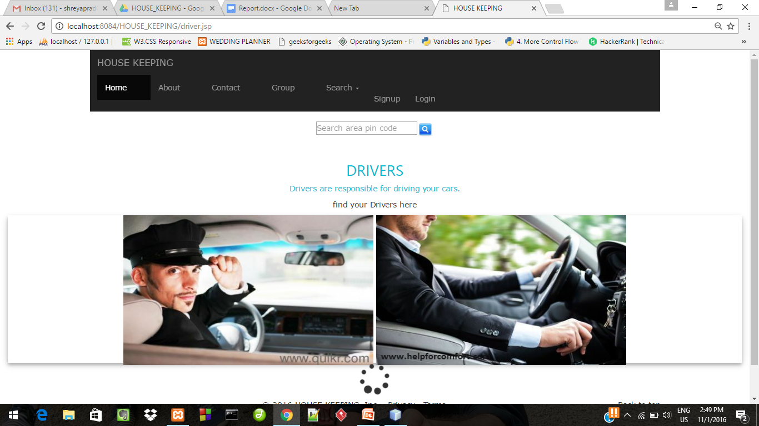
continue

Slide 12
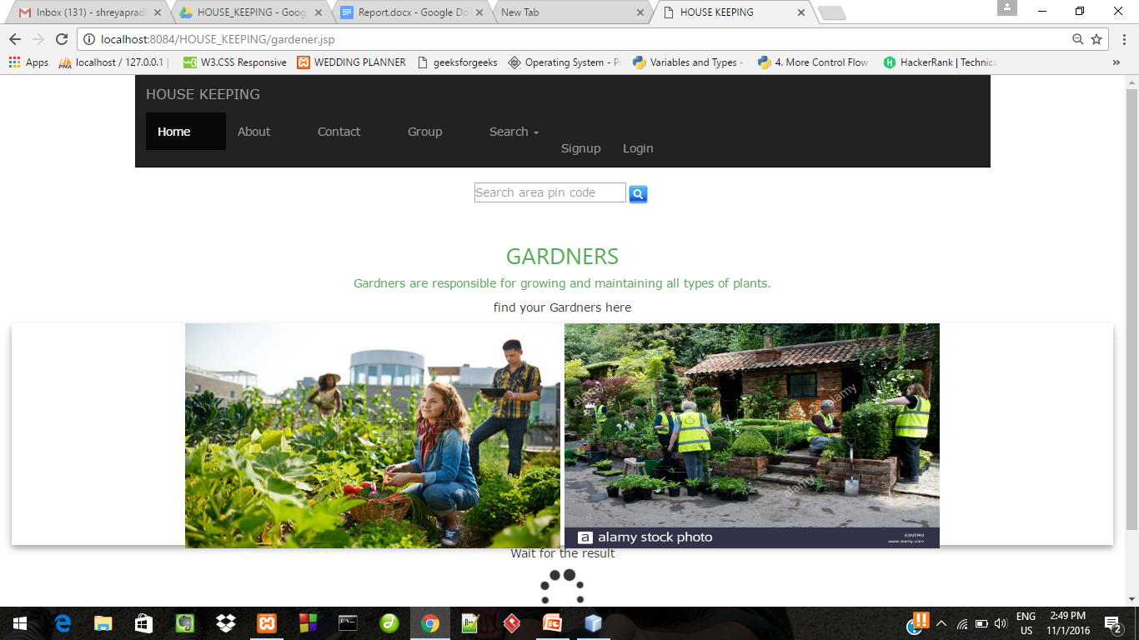
Continue

Slide 13
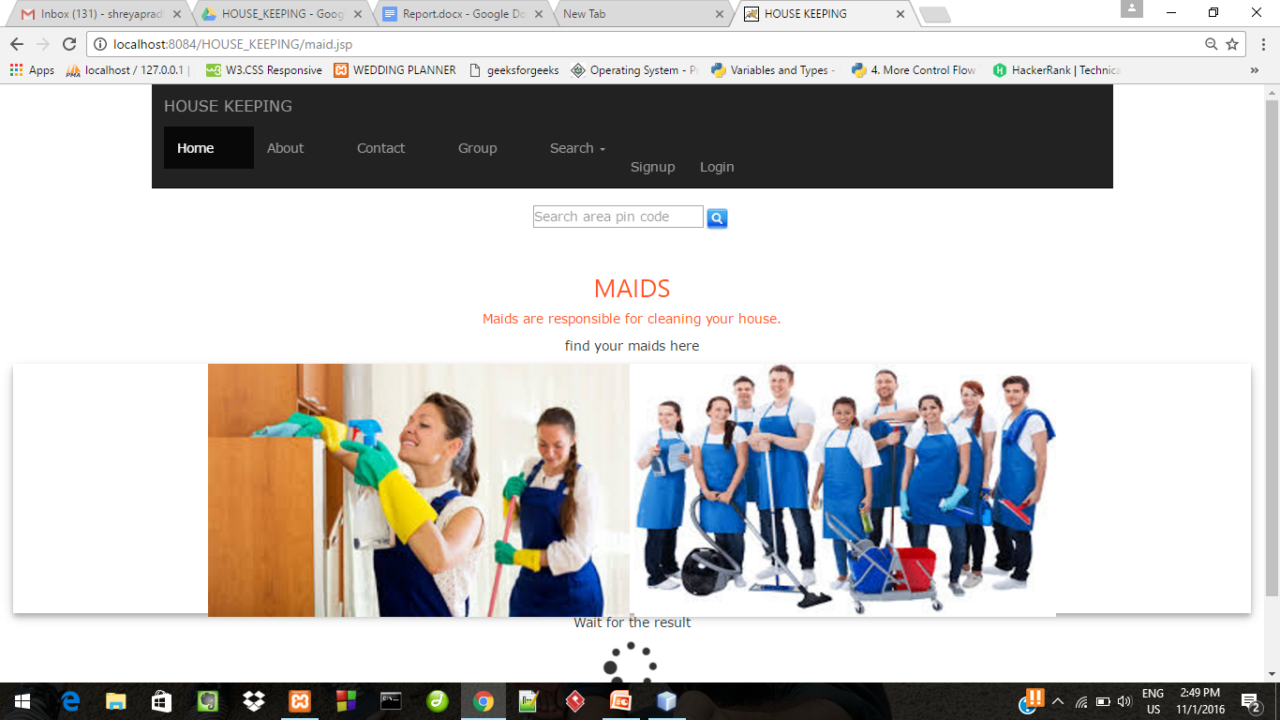

Slide 14
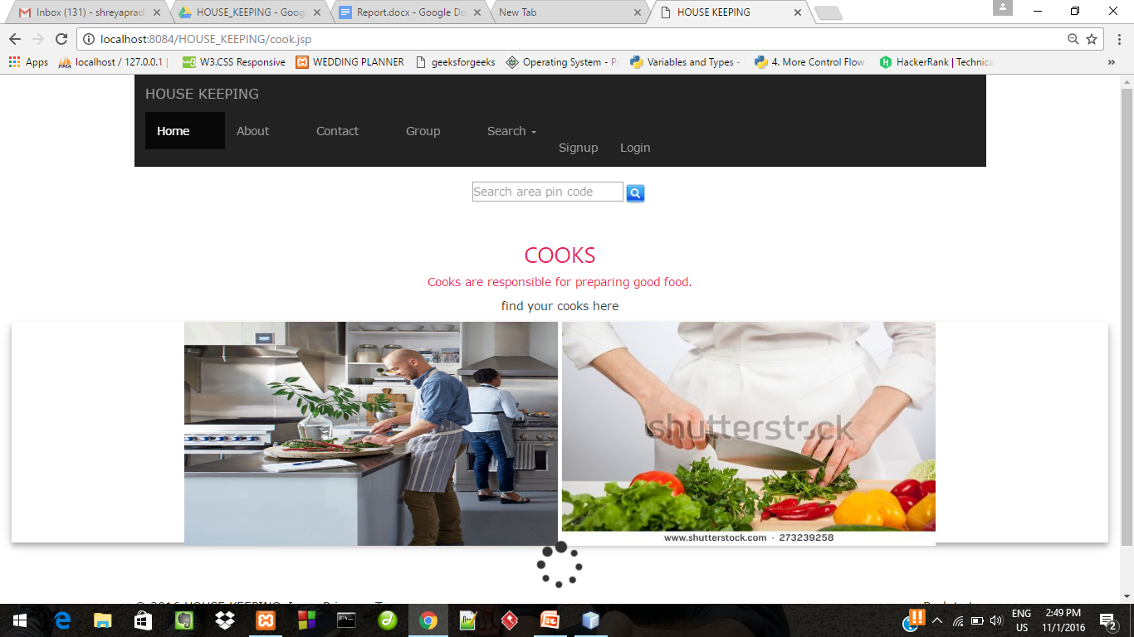

Slide 15
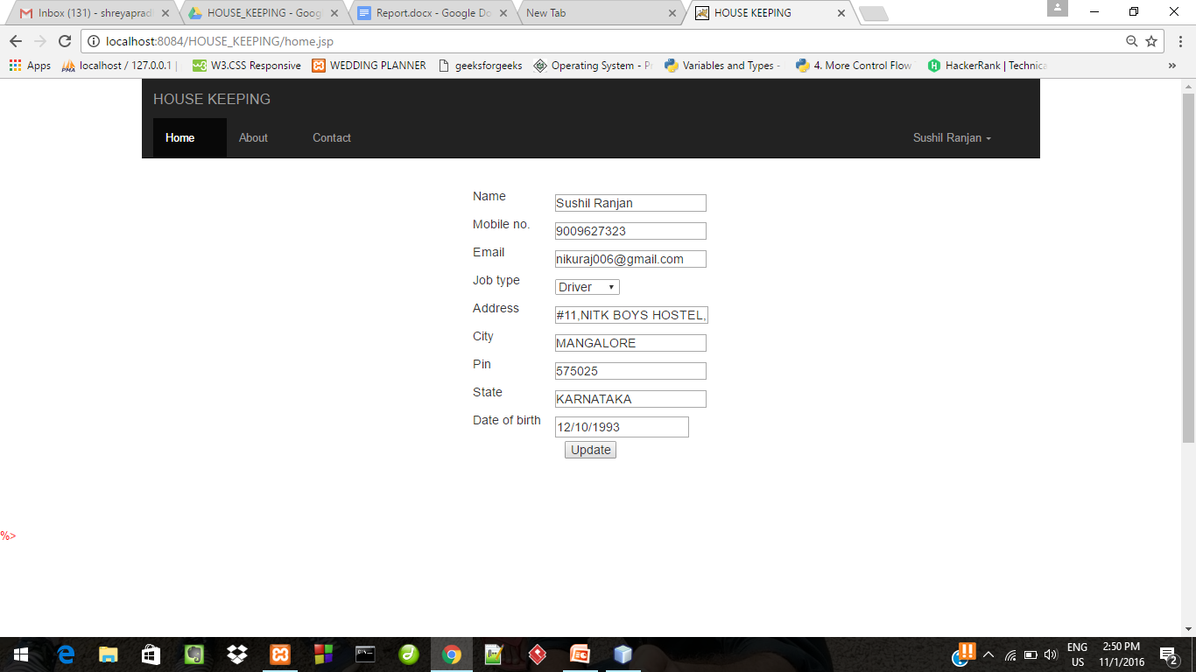

Slide 16
Conclusion
The customer will get the details of the servant, which he has chosen.
The details will include the contact no., name ,email id of the customer.
The Customer can use this details to contact personally to the servant.

Slide 17
References
www.google.com
www.quicker.com

